Slide 1
Hello OSINT
Its what you do before that matters
Notes:
This will be a quick overview of something to set up and consider during your OSINT investigations

Slide 2


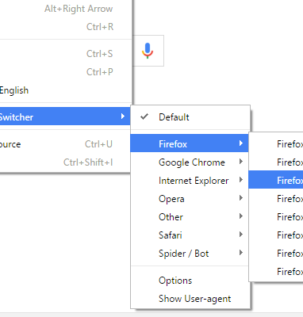

User agent
Notes:
We want to make sure that we know what we look like when requesting material. http://whatu.info/ Check out how you appear to the host machine. cURL –A “enter info here” will also change the user agent

Slide 3


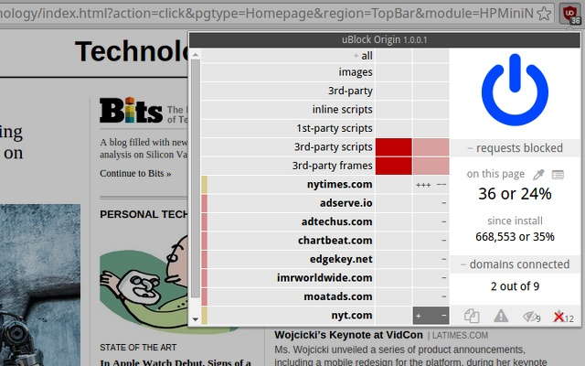
AD blockers
Not all built the same

Slide 4




Setting up the investigation
Notes:
Remember your targets, your threat landscape and what you are after. Password managers are a must with sock puppet accounts, VPN will assist getting past certain search areas or targets and A VM is always a nice to have. I think it’s a must in most cases but depends on the targets and the ability of your ORG. Also remember Android Emulators for “friend” targeting on certain apps.

Slide 5
Starting the investigation
Notes:
So we are about to start the investigation. Depending on what level of control you have, ask the questions. Is this safe? Am I protected? If we discover sensitive information, what's my recourse? What If there is abuse or violations of the law? Who do I report to? Etc… make sure that you are not so blinded by the hunt that you do something stupid. Quick note on search engines. Use them all. Yandex is awesome at reverse and Facial recon. Bing is the wild west and google knows everything. Yahoo might even help but look at Carrotv2, DDG, swisscows…you might also find industry specific search engines

Slide 6

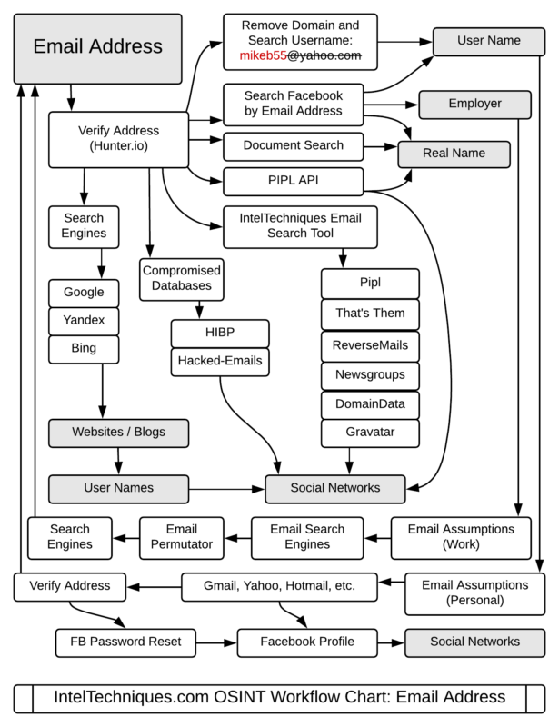
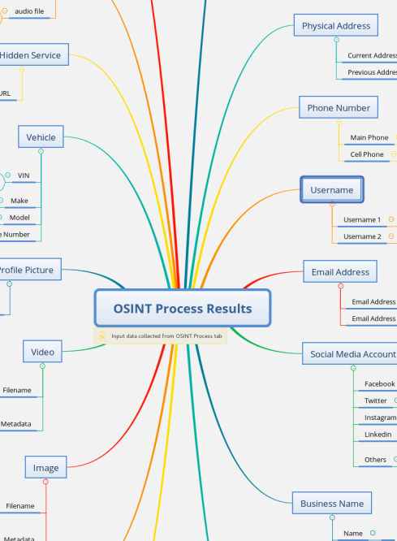
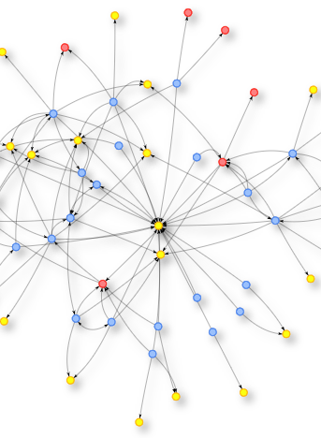

Mind maps and workflows
Notes:
So that the investigation is focused, we need to know what to search for or pivot off. These are some excellent resources. Your OSINT Graphical Analyzer

Slide 7

Business recon
Spiderfoot (HX)
Open Corporations
Bloomberg
ReHold
LinkedIn
The Harvester
ViewDNS Info
Analytics Tracking
Google Dorks
CrunchBase
SecurityTrails
Hunter.io
Notes:
Are you looking into a company? What is the scope of the work? Are you looking to vet a company that is being taken over, looking for insider threats or checking out the competition for business intelligence?

Slide 8

Social media recon
Spiderfoot (HX)
Recon-ng profile module
Social Links
MyLife.com
snapdex.com
Spokeo
ThatsThem
True People Search

Slide 9
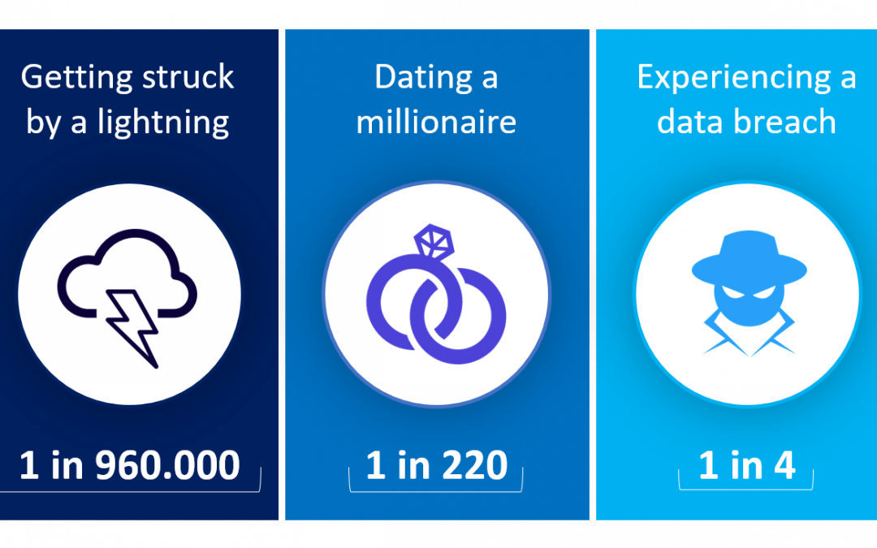
Breach Data recon
Spiderfoot (HX)
WeLeakInfo
DeHashed
HaveIbeenpwned
Snusbase
IntelX.io

Slide 10
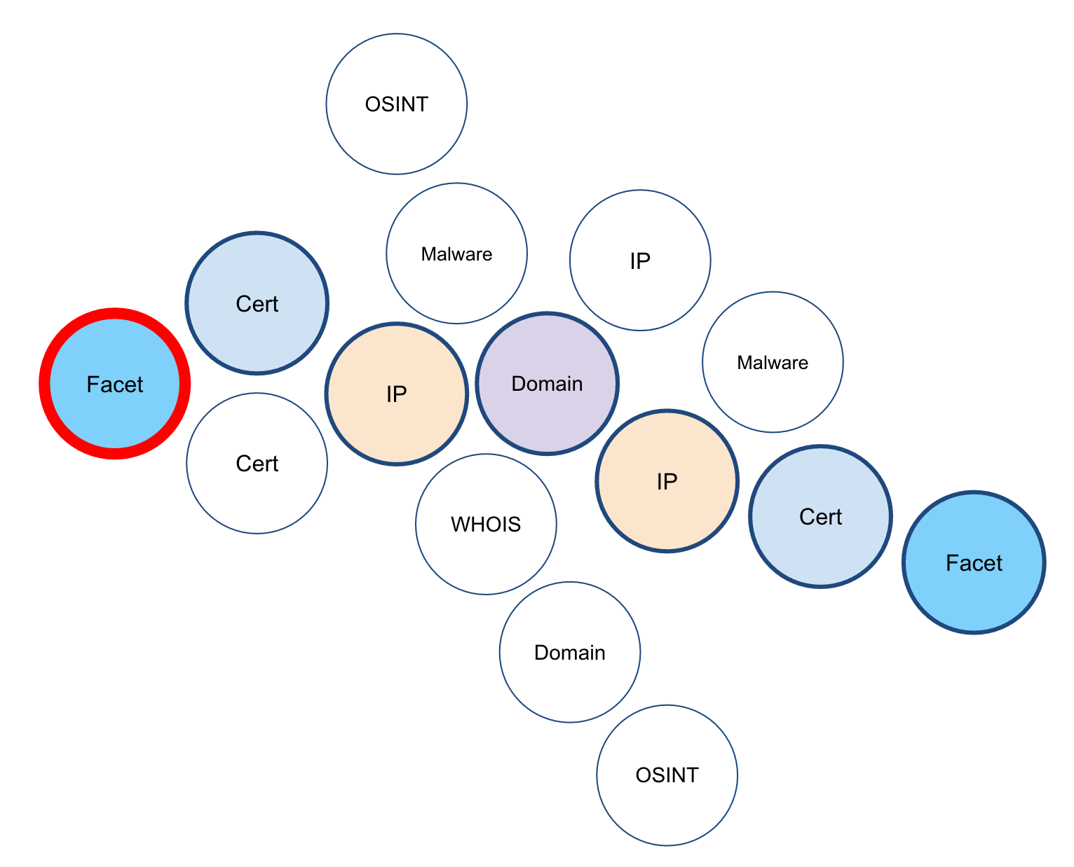
Infra OSINT
VeiwDNS.info
Censys
Shodan
BinaryEdge
Zoomeye
BuiltWith
Kamerka
certstream.calidog.io

Slide 11
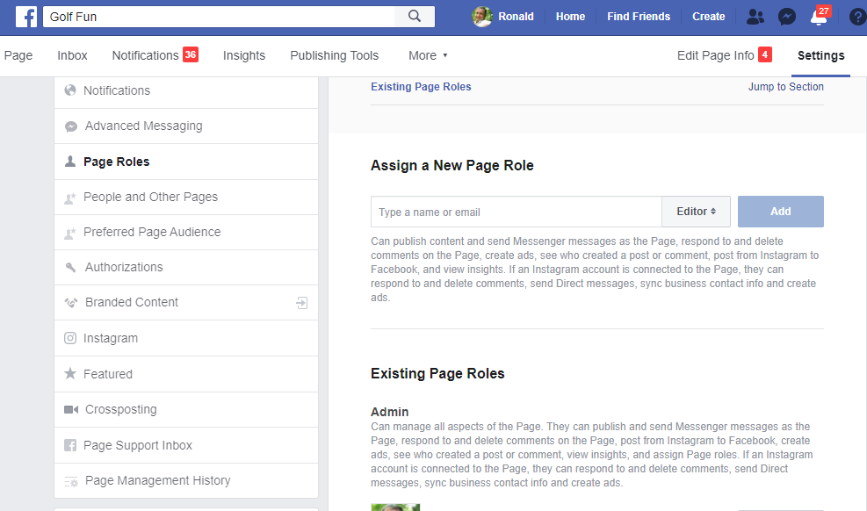
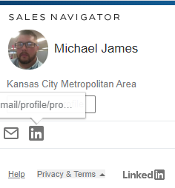
Tools and techniques
https://www.linkedin.com/sales/gmail/profile/viewByEmail/EMAIL

Slide 12
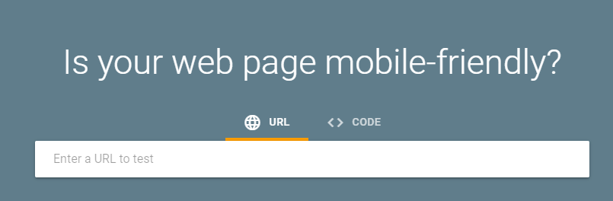

https://search.google.com/test/mobile-friendly

Slide 13
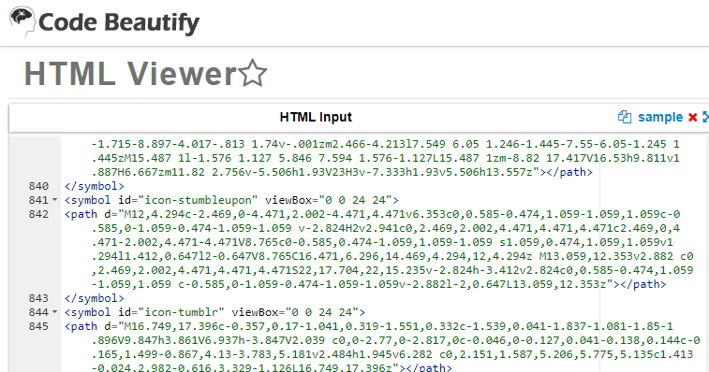
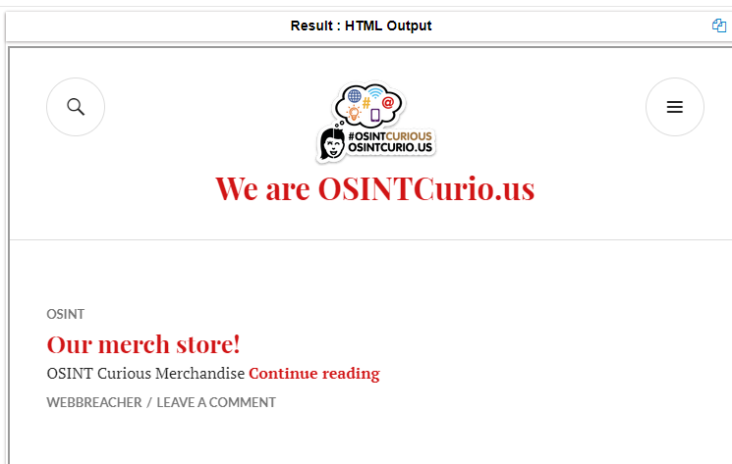
Sneaky sneaky….

Slide 14

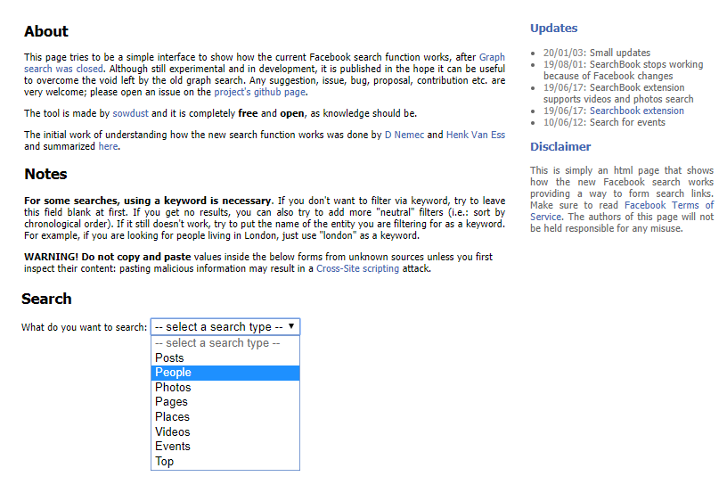

Slide 15

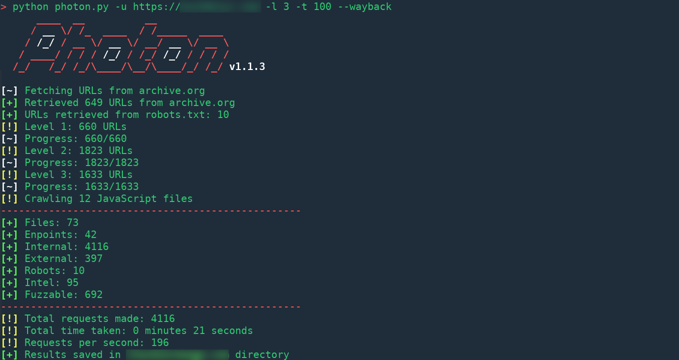
Photon
https://github.com/s0md3v/Photon
Photon

Slide 16




Slide 17
Questions?
Thank you ☺
Ginsberg5150 on Twitter
OSINTCurio.us
OSINT.Team
SecKC.org
TraceLabs.com
https://github.com/ginsberg5150

